Slide 1
Write test case effectively
Anh Kim Ngo

Slide 2
Agenda
What’s test case used for?
Write & use test case in Automation (Selenium)
Test title
Test description
Precondition
Test data
Test steps
Expected result
Q&A

Slide 3
What’s test case used for?
Manual test
Client acceptance testing
Guideline
Automation test

Slide 4
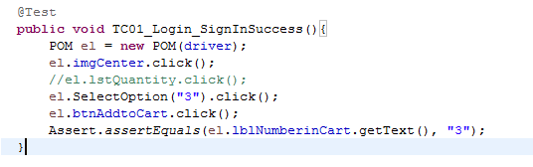
Test title
Write:
Test case naming convention as “TC[number]_Feature/Page_Testcasename” . Example: TC01_Login_SignInSuccess
Use ‘verb’ for the beginning of test case name
Use:
In Automation test, it’s associated with test method name

Slide 5
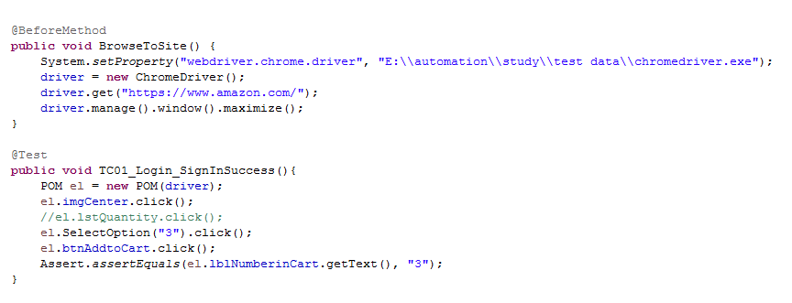
Precondition
Write:
Any user data dependency (e.g. the user should be logged in, which page should the user start the journey, etc.)
Any special setup/configuration to be done before Test Execution
Dependencies on any other test cases – does the Test Case need to be run before/after some other Test Case? (e.g TC01_EditView_CreatePageA => precondition of TC02_EditView_EditPageA would be TC01_…)
Use:
Optional
In Automation test: used at initial method (e.g @BeforeTest attribute)

Slide 6
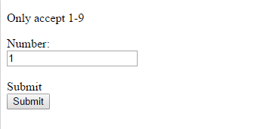
Test data
Write:
No data
Valid data
Invalid/illegal data
Boundary condition data
Data set for performance testing
Example:
2. In Automation: each type of data set will be stored in each sheet/excel file

Slide 7
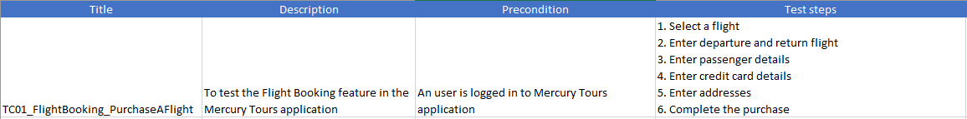
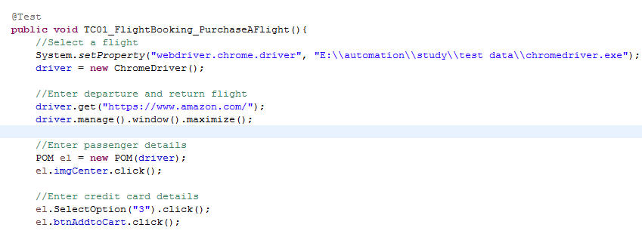
Test steps
Details level:
Very detailed: Manual testers without application knowledge, steps need to be 100% exact.
A bit detailed: Client acceptance testing, guidelines to trigger client into testing their personal workflows.
Less detailed: Automated tests, high level steps might be sufficient in the test-case descriptions. Just enough to be able to understand what needs to be automated. Details are later defined in the tests it self
In Automation: each step should be commented

Slide 8
Expected result
Each test step should clearly mention what you expect as outcome of that verification step
Mention in detail what page/screen you expect to appear after the test and, any updates you expect as an outcome to be made in back-end systems or database
You can also attach screenshots or specification documents to the relevant step mentioning the system should work as outlined in the given document to make things simpler.

Slide 9
Q&A

